Slide 1
UNIT 5
Speaking: E-commerce

Slide 2
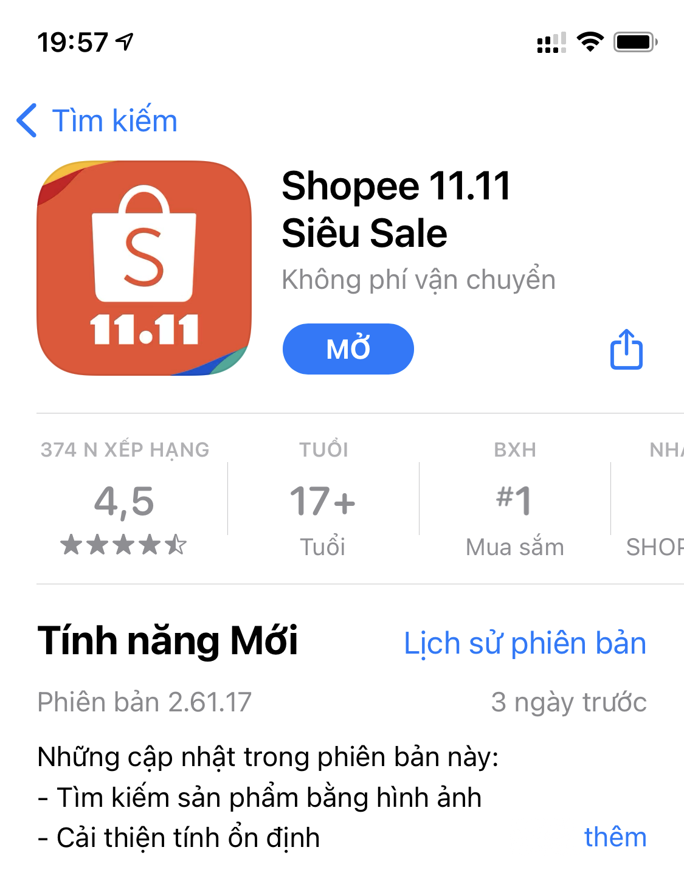
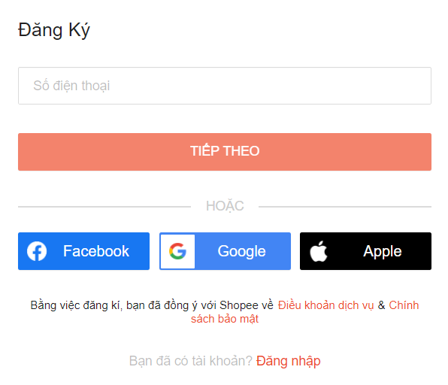
Download app
or use web version
What is Shopee?
E-commerce
Register account
Notes:
Shopee is an e-commerce site which was founded in 2015 and are available currently in Singapore, Malaysia, Thailand, Taiwan, Indonesia, Vietnam, Philippines, and Brazil.
Enjoy shopping online anytime anywhere on Shopee in just two simple steps.
Step one download shopee via the App Store or Google Play.
Step two register an account using your mobile number
That's all it takes.

Slide 3
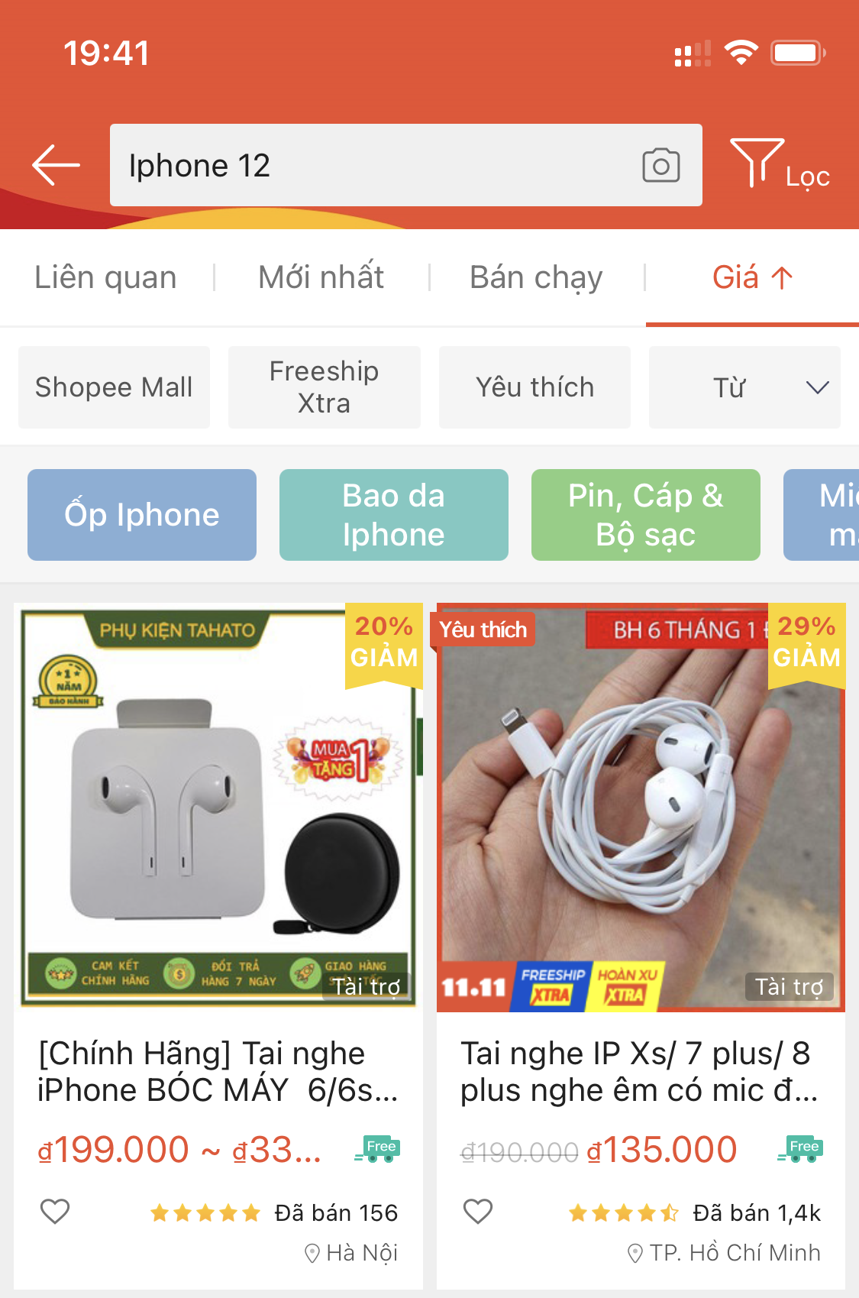
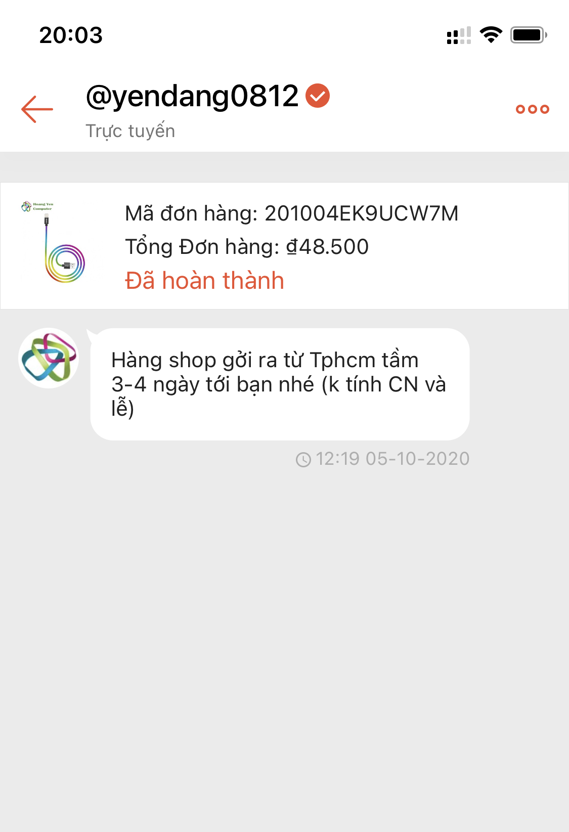
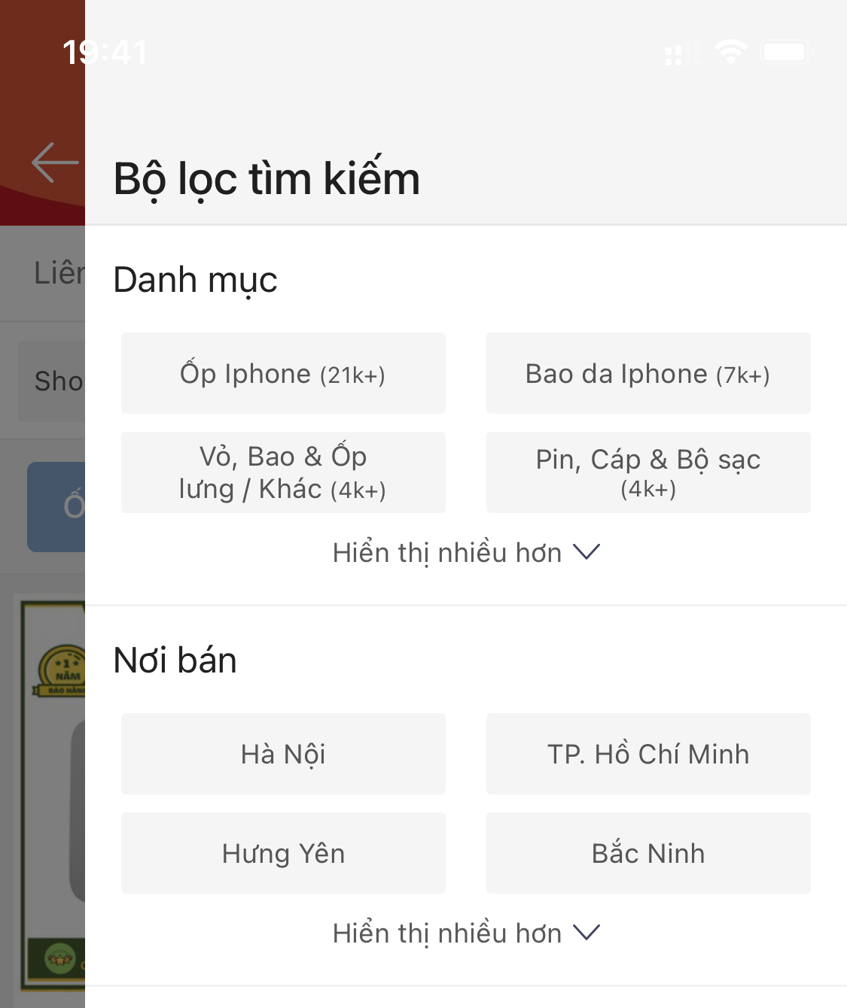
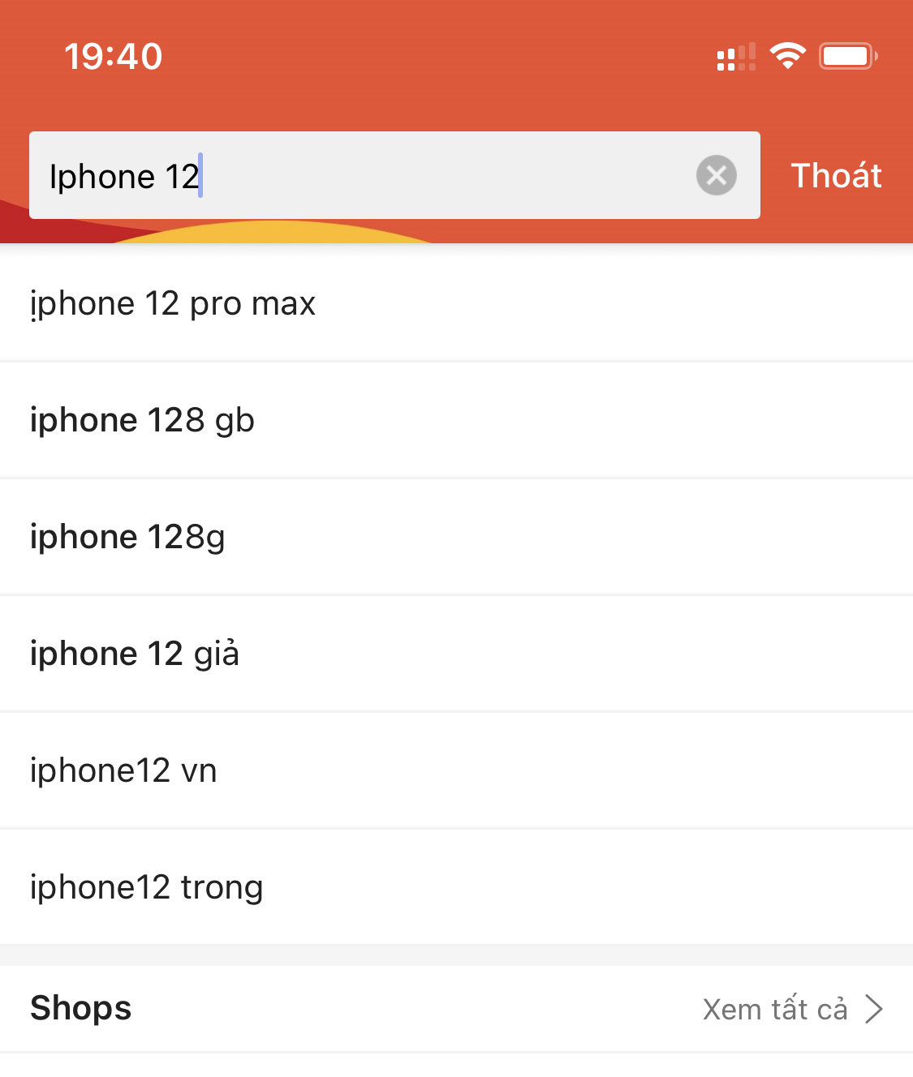
Filter
Search bar
Product
Live chat
What is Shopee?
Notes:
Start shopping on shopee by searching for the product you're looking for using the search bar or browse through our wide range of categories and products from different sellers.
If you have any questions about the product, you can use a live chat to chat with the sellers in real time.

Slide 4
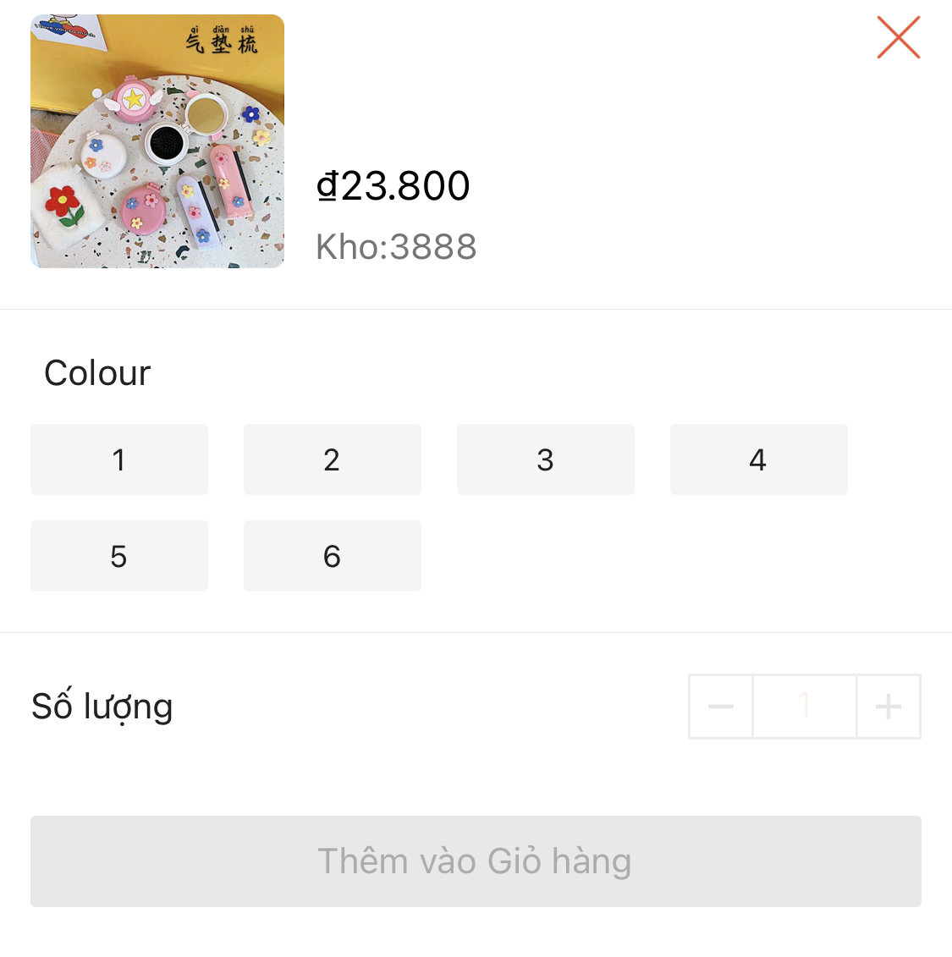
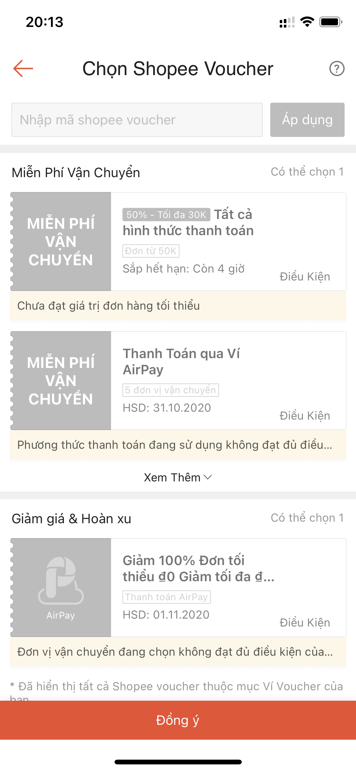

Found
a product
you love
Simply add the product to your cart
Vouchers
What is Shopee?
Notes:
Found a product you love
Simply add the product to your cart.
You can even use vouchers to enjoy further discounts
Upon checkout choose your preferred mode of delivery from a wide range of career services island-wide
Complete your purchase with a peace of mind via four different payment methods to choose from credit or debit card, credit cart installment plans, bank transfer and shopee pay.

Slide 5




Advantages ?
Low financial cost
shopping convenience
Save time

Slide 6


Quality is not controlled
Wait for the delivery
Disadnvantage

Slide 7
THANK FOR YOUR ATTENTION

